Slide 1
Computer Programming: JAVA
Module-5 - Exception Handling
Dr. S.A. Amutha Jeevakumari Assistant Professor
School of Computer Science and Engineering VIT - Chennai
CSE1007-Javarogramming

Slide 2

Contents
Exception Handling Exceptions & Errors Types of Exception
Control Flow in Exceptions
Use of try, catch, finally, throw, throws in Exception Handling User Defined Exceptions
CSE1007-Java Programming

Slide 3
Exception Handling
Exception handling is one of the most important feature of java programming that allows us to handle the runtime errors caused by exceptions.
It is a mechanism to handle runtime errors such as ClassNotFoundException, IOException, (Structured Query Language)SQLException, RemoteException, etc.
What is an Exception?
An Exception is an unwanted event that interrupts the normal flow of the program and terminates program abruptly.
Why an exception occurs?
There can be several reasons that can cause a program to throw exception. For Example: Opening a non-existing file in your program, Network connection problem, bad input data provided by user etc.
Advantages :
It ensures, the flow of the program doesn’t break when an exception occurs. By handling, make sure that all the statements execute and the flow of program doesn’t break.

Slide 4
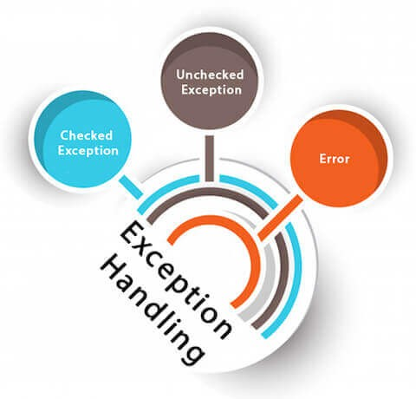
Exception Handling
Error Vs Exception
Error: indicates serious problem that a reasonable application should not try to catch. Exception: indicates conditions that a reasonable application might try to catch.
Types of Exceptions
There are mainy 2 types of Exceptions. But, as per Oracle, they are :
Checked Exception Unchecked Exception Error (Unchecked Exception)

Slide 5
Types of Exceptions
1
Checked Exceptions :
All exceptions other than Runtime Exceptions are known as Checked exceptions as the compiler checks them during compilation to see whether the programmer has handled them or not.
If these exceptions are not handled/declared in the program, you will get compilation error.
Example : SQLException, IOException, ClassNotFoundException etc.
2
Un-Checked Exceptions :
Runtime Exceptions are also known as Unchecked Exceptions.
These exceptions are not checked at compile-time so compiler does not check whether the programmer has handled them or not but it’s the responsibility of the programmer to handle these exceptions and provide a safe exit.
Example : ArithmeticException, NullPointerException, ArrayIndexOutOfBoundsException etc.
3
Error : It is irrecoverable
Example : OutOfMemoryError, VirtualMachineError, AssertionError etc.
CSE1007-Java Programming

Slide 6
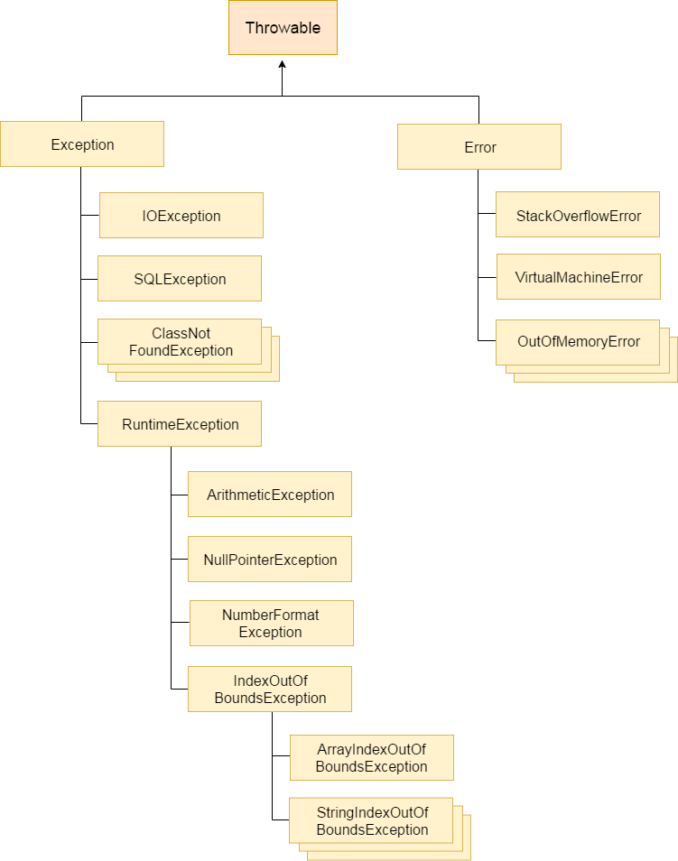
Hierarchy of Java Exception classes
The java.lang.Throwable class is the root class of Java Exception hierarchy which is inherited by two subclasses:
Exception and Error.

Slide 7
Exceptions...!
Common scenarios where exceptions may occur :
int a=50/0; String s=null;
System.out.println(s.length());
String s="abc";
int i=Integer.parseInt(s);
int a[]=new int[5]; a[10]=50;
//ArithmeticException
1
2
//NullPointerException
3
//NumberFormatException
//ArrayIndexOutOfBoundsException
4
CSE1007-Java Programming

Slide 8
Exceptions : Real Time Scenarios
Imagine that you are driving a car on a straight road in a national highway with high speed. When suddenly a dog comes from the bushes on the central divider and crosses the road. After spotting the dog, you started to apply the brakes. But, to bring down your car from such a high speed takes time and it hit the dog. What is the inference on the above situation?
Assume that you want to reach a particular destination. The actual travelling time of the destination is 30 minutes but you started 1 hour before. Why?
Imagine that you have developed a program to read only the numbers as inputs, and by mistake if you read an alphabet or a string. What is the impact of the output and how to handle this situation?
Assume that you are searching a file in the hard disk, if it is not available, then how to handle this situation?
CSE1007-Java Programming

Slide 9
Checked Exceptions
Java defines several exception classes inside the standard package java.lang.
Sr.No. | Exception & Description
1 | ClassNotFoundException Class not found.
2 | CloneNotSupportedEx ception Attempt to clone an object that does not implement the Cloneable interface.
3 | IllegalAccessException Access to a class is denied.
4 | InstantiationException Attempt to create an object of an abstract class or interface.
5 | InterruptedException One thread has been interrupted by another thread.
6 | NoSuchFieldException A requested field does not exist.
7 | NoSuchMethodException A requested method does not exist.

Slide 10
UnChecked Exceptions
Sr.No. | Exception & Description
1 | ArithmeticException Arithmetic error, such as divide-by-zero.
2 | ArrayIndexOutOfBoundsException Array index is out-of-bounds.
3 | ArrayStoreException Assignment to an array element of an incompatible type.
4 | ClassCastException Invalid cast.
5 | IllegalArgumentException Illegal argument used to invoke a method.
6 | IllegalMonitorStateException Illegal monitor operation, such as waiting on an unlocked thread.
7 | IllegalStateException Environment or application is in incorrect state.
8 | IllegalThreadStateException Requested operation not compatible with the current thread state.

Slide 11
UnChecked Exceptions
Sr.No. | Exception & Description
9 | IndexOutOfBoundsException Some type of index is out-of-bounds.
10 | NegativeArraySizeException Array created with a negative size.
11 | NullPointerException Invalid use of a null reference.
12 | NumberFormatException Invalid conversion of a string to a numeric format.
13 | SecurityException Attempt to violate security.
14 | StringIndexOutOfBounds Attempt to index outside the bounds of a string.
15 | UnsupportedOperationException An unsupported operation was encountered.
CSE1007-Java Programming

Slide 12
Jave Exception Methods
Sr.No. | Method & Description
1 | public String getMessage() : Returns a detailed message about the exception that has occurred. This message is initialized in the Throwable constructor.
2 | public Throwable getCause() : Returns the cause of the exception as represented by a Throwable object.
3 | public String toString() : Returns the name of the class concatenated with the result of getMessage().
4 | public void printStackTrace() : Prints the result of toString() along with the stack trace to System.err, the error output stream.
5 | public StackTraceElement [] getStackTrace() : Returns an array containing each element on the stack trace. The element at index 0 represents the top of the call stack, and the last element in the array represents the method at the bottom of the call stack.
6 | public Throwable fillInStackTrace() : Fills the stack trace of this Throwable object with the current stack trace, adding to any previous information in the stack trace.
CSE1007-Java Programming

Slide 13
There are 5 keywords which are used in handling exceptions in Java.
Java Exception Keywords
Keyword | Description
try | It is used to specify a block where we should place exception code. It must be followed by either catch or finally. It means, we can’t use try block alone.
catch | It is used to handle the exception. It must be preceded by try block which means we can’t use catch block alone. It can be followed by finally block later.
finally | It is used to execute the important code of the program. It is executed whether an exception is handled or not.
throw | is used to throw an exception.
throws | It is used to declare exceptions. It doesn’t throw an exception. It specifies that there may occur an exception in the method. It is always used with method signature.
CSE1007-Java Programming

Slide 14
try and catch block
Syntax :
// The try and catch keywords come in pairs:
try {
......
......
// Block of code to try
......
......
}
catch(Exception e) {
......
......
// Block of code to handle errors
......
......
}
CSE1007-Java Programming

Slide 15
Example-1 : Exception Handling
Without Exception Handling
public class Exception-1 {
public static void main(String[ ] args) { int[] myNum= {1, 2, 3}; System.out.println(myNum[10]); // error!
}
}
// Exception in thread "main" java.lang.ArrayIndexOutOfBoundsException: 10
// at Main.main(Main.java:4)
With Exception Handling
public class Exception-1 {
public static void main(String[ ] args) {
try {
int[] myNum= {1, 2, 3}; System.out.println(myNum[10]);
}
catch (Exception e) { System.out.println("Something went wrong.");
}
}
}
// Something went wrong.
CSE1007-Java Programming

Slide 16
Example-2 : Exception Handling
Without Exception Handling
public class Testtrycatch1 {
public static void main(String args[]){
int data=50/0;
System.out.println("rest of the code...");
}
}
Output: Exception in thread main java.lang.ArithmeticException:/ by zero (rest of the code is not executed)
With Exception Handling
public class Testtrycatch1{
public static void main(String args[]){
try{
int data=50/0;
}catch(ArithmeticException e){System.out.println(e);} System.out.println("rest of the code...");
}
}
Output: Exception in thread main java.lang.ArithmeticException:/ by zero rest of the code...
CSE1007-Java Programming

Slide 17
Example-3 : Multiple catch block
public class MultipleCatchBlock{
public static void main(String args[]){
try{
int a[]=new int[5]; a[5]=30/0;
}
catch(ArithmeticException e){ System.out.println("Arithmetic Exception Caught");
}
catch(ArrayIndexOutOfBoundsException e) { System.out.println("ArrayIndexOutOfBound Exception");
}
catch(Exception e){ System.out.println("Default Exception");
}
System.out.println("Rest of the code...");
}
}
Output:
Arithmetic Exception Caught Rest of the code...
CSE1007-Java Programming

Slide 18
Example-4 : Multiple catch (Ordered) block
public class MultipleCatchBlock{
public static void main(String args[]){
try{
int a[]=new int[5]; a[5]=30/0;
}
catch(Exception e){ System.out.println("Default Exception");
}
catch(ArithmeticException e){ System.out.println("Arithmetic Exception Caught");
}
catch(ArrayIndexOutOfBoundsException e) { System.out.println("ArrayIndexOutOfBound Exception");
}
System.out.println("Rest of the code...");
}
}
Output: Compilation Error
CSE1007-Java Programming

Slide 19
Example-5
package Rajkumar; class Multiple{
public static void main(String args[]) {
try {
int a=args.length;
//Do not give any argument during execution and
//check the result
System.out.println("a="+a);
int b=5/a; int c[]={3}; c[10]=87;
}
catch(ArrayIndexOutOfBoundsException e) { System.out.println("Array Index Out of Bound"+e);
}
catch(ArithmeticException e) { System.out.println("Divide by ze System.out.println("After try/catch block");
}
}
// Divide by zerojava.lang.ArithmeticException: / by zero
// After try/catch block
CSE1007-Java Programming

Slide 20
Flow control in try & catch block
Control flow occurs in each of the given case:
Control flow in try-catch clause OR try-catch-finally clause
Case 1: Exception occurs in try block and handled in catch block Case 2: Exception occurs in try-block is not handled in catch block Case 3: Exception doesn’t occur in try-block
try-finally clause
Case 1: Exception occurs in try block
Case 2: Exception doesn’t occur in try-block
CSE1007-Java Programming

Slide 21
Nested try Block
Definition
Block within another Block is called as Nested Block.
The try block within a try block is known as Nested try block.
Why use nested try block. . . ?
Sometimes a situation may arise where a part of a block may cause one error
and the entire block itself may cause another error.
In such cases, exception handlers have to be nested.
....
try
{
statement 1;
statement 2;
try {
statement 1;
statement 2;
}
catch(Exception e) {
}
}
catch(Exception e) {
....
}
CSE1007-Java Programming

Slide 22
Example-6 : Nested try block
class NestedException{
public static void main(String args[]){
try{
try{
System.out.println("going to divide");
int b =39/0;
}
catch(ArithmeticException e){System.out.println(e);}
try{
int a[]=new int[5]; a[5]=4;
}
catch(ArrayIndexOutOfBoundsException e){ System.out.println(e);
}
System.out.println("other statement");
}
catch(Exception e){System.out.println("handeled");} System.out.println("normal flow..");
}
}
CSE1007-Java Programming

Slide 23
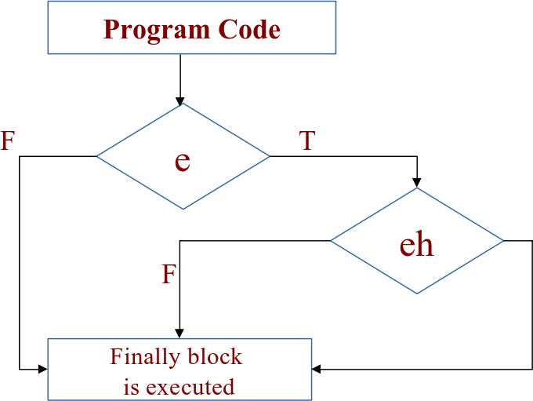
Java finally block
It is used to execute vital code such as closing connection, stream etc. It is always executed whether exception is handled or not.
It must be followed by try or catch block.
Why Use Java finally?
It is used to put "clean-up" code such as closing a file, closing connection etc.
CSE1007-Java Programming

Slide 24
Example -7 : Without & With finally block
Without finally
package Rajkumar; class withoutfinally1{
public static void main(String args[]){
try{ int a=args.length; int x=5/a; } System.out.println("Statement is placed without finally block");
}
}
// Exception in thread "main" java.lang.Error: Unresolved compilation problem:
// Syntax error, insert "Finally" to complete BlockStatements
// at withoutfinally1.main(withoutfinally1.java:6)
With finally
package Rajkumar; class finally1 {
public static void main(String args[]) {
try { int a=args.length; int x=5/a; } catch(ArithmeticException e){ System.out.println(e); } finally{ System.out.println("Finally statement"); }
}
}
// java.lang.ArithmeticException: / by zero
// Finally statement
CSE1007-Java Programming

Slide 25
Example-8 : finally block
class FinallyBlock-1{
public static void main(String args[]){
try{
int data=25/5; System.out.println(data);
}
catch(NullPointerException e){ System.out.println(e);
}
finally{
System.out.println("finally block is always executed");
}
System.out.println("rest of the code...");
}
}
Output: 5
finally block is always executed rest of the code...
CSE1007-Java Programming

Slide 27
Example-9 : finally block
package Rajkumar; class example2 {
public static void main(String args[]){
int a=5,b=0;
try{ System.out.println(a/b); }
catch(ArithmeticException e) { System.out.println(e); } finally { System.out.println("This is the finally statement"); System.out.println("This is the statement after finally");
}
}
// java.lang.ArithmeticException: / by zero
// This is the finally statement
// This is the statement after finally
CSE1007-Java Programming

Slide 28
Example-10 : finally block
package Rajkumar; class example3 {
public static void main(String args[]) {
int a=5,b=0;
try { System.out.println(a/b); }
catch(ArrayIndexOutOfBoundsException e) { System.out.println(e);
}
finally { System.out.println("This is the finally statement"); System.out.println("This is the statement after finally");
}
}
// This is the finally statement
// Exception in thread "main" java.lang.ArithmeticException: / by zero
// at example3.main(example3.java:4)
CSE1007-Java Programming

Slide 29
Example-11 : finally block
class FinallyBlock-2{
public static void main(String args[]){
try{
int data=25/0; System.out.println(data);
}
catch(NullPointerException e){ System.out.println(e);
}
finally{
System.out.println("finally block is always executed");
}
System.out.println("rest of the code...");
}
}
Output:
finally block is always executed
Exception in thread main java.lang.ArithmeticException:/ by zero
CSE1007-Java Programming

Slide 30
Example-12 : finally block
class FinallyBlock-3{
public static void main(String args[]){
try{
int data=25/0; System.out.println(data);
}
catch(ArithmeticException e){
System.out.println(e);
}
finally{
System.out.println("finally block is always executed");
}
System.out.println("rest of the code...");
}"The 'try catch' is finished."
}
Output:
Exception in thread main java.lang.ArithmeticException:/ by zero
finally block is always executed rest of the code..
CSE1007-Java Programming

Slide 31
Example-13
package Rajkumar; class except1{
public static void main(String args[]) {
try {
int a=10,b=0,c; c=a/b;
System.out.println("the value of c " +c);
}
catch(ArithmeticException a) { System.out.println("Exception generated"+a);
}
}
}
// Exception generatedjava.lang.ArithmeticException: / by zero
CSE1007-Java Programming

Slide 32
Example-14
package Rajkumar; class except2{
public static void main(String args[]) {
int i[]={20,40};
try {
i[10]=20;
}
catch(ArrayIndexOutOfBoundsException e) { System.out.println("Exception generated"+e);
}
}
}
// Exception generatedjava.lang.ArrayIndexOutOfBoundsException:
// Index 10 out of bounds for length 2
CSE1007-Java Programming

Slide 33
Example-15
package Rajkumar; class except3{
public static void main(String args[]) {
try{
int a[]=new int[-10]; System.out.println("First element:"+a[0]);
System.out.println("After the exception block");
}
catch(NegativeArraySizeException n){ System.out.println("Generated Exception "+n);
}
System.out.println("After the catch block");
}
}
// Generated Exception java.lang.NegativeArraySizeException: -10
// After the catch block
CSE1007-Java Programming

Slide 34
Java throw keyword
It is used to explicitly throw an exception either checked or uncheked.
It is mainly used to throw custom exception.
Syntax : throw exception;
Example : throw new IOException("sorry device error);
Consider the below program :
public class TestThrow-1{
static void validate(int age){
if(age<18)
throw new ArithmeticException("not valid");
else
System.out.println("welcome to vote");
}
public static void main(String args[]){ validate(13);
System.out.println("rest of the code...");
}
}
// Exception in thread main java.lang.ArithmeticException:not valid
CSE1007-Java Programming

Slide 35
Java throws keyword
It is used to declare an exception.
It gives an information to the programmer that there may occur an exception so it is better for the programmer to provide the exception handling code so that normal flow can be maintained.
Exception Handling is mainly used to handle the checked exceptions.
If there occurs any unchecked exception such as NullPointerException, it is programmers fault that he is not performing check up before the code being used.
Syntax :
return_type method_name() throws exception_class_name {
......
//method code
......
}
CSE1007-Java Programming

Slide 36
Java throws keyword
Which exception should be declared?
Ans : checked exception only,
unchecked Exception: under your control so correct your code. error: beyond our control
Advantage of Java throws keyword
Now Checked Exception can be propagated (forwarded in call stack).
It provides information to the caller of the method about the exception.
CSE1007-Java Programming

Slide 37
Example-16 : Java throws block
import java.io.IOException; class Testthrows1{
void m() throws IOException{
throw new IOException("device error");
}
void n() throws IOException{ m(); }
void p(){
try{ n(); }
catch(Exception e){ System.out.println("exception handled");
}
//check
}
public static void main(String args[]){ Testthrows1 obj=new Testthrows1(); obj.p();
System.out.println("normal flow...");
}
}
//
//
exception handled normal flow...
CSE1007-Java Programming

Slide 38
Example-17 : Java throws block
Case-1: You handle the exception
import java.io.*; class M{
void method()throws IOException{
throw new IOException("device error");
}
}
public class Testthrows2{
public static void main(String args[]){
try{
M m=new M(); m.method();
}catch(Exception e) { System.out.println("exception System.out.println("normal flow...");
}
}
// exception handled
// normal flow...
CSE1007-Java Programming

Slide 39
Example-18 : Java throws block
Case-2: You declare the exception
A) Program if exception does not occur
import java.io.*; class M{
void method()throws IOException{ System.out.println("device operation performed");
}
}
class Testthrows3{
public static void main(String args[])throws IOException{ M m=new M();
m.method(); System.out.println("normal flow...");
}
}
// device operation performed
// normal flow...
/
CSE1007-Java Programming
38/ 118

Slide 40
Example-19 : Java throws block
Case-2: You declare the exception
B) Program if exception occurs
import java.io.*;
class M{
void method()throws IOException{
throw new IOException("device error");
}
}
class Testthrows4{
public static void main(String args[])throws IOException{//declare M m=new M();
m.method(); System.out.println("normal flow...");
}
}
// Runtime Exception
CSE1007-Java Programming

Slide 41
Example-20
package Rajkumar; import java.io.*; class except4 {
public static void main(String a[]) throws Exception {
int a1;
try {
DataInputStream d=new DataInputStream(System.in); System.out.println("Enter the no"); a1=Integer.parseInt(d.readLine());
}
catch(NumberFormatException e) { System.out.println(e); }
}
}
// Enter the no : Hi Rajkumar
// java.lang.NumberFormatException: For input string: "Hi Rajkumar"
CSE1007-Java Programming

Slide 43
Example-21 : Java Exception
import java.io.File; import java.io.FileReader;
import java.io.IOException; public class ReadData_Demo {
public static void main(String args[]) { FileReader fr = null;
try{
File file = new File("file.txt");
fr = new FileReader(file); char [] a = new char[50]; fr.read(a); // reads the content to the array
// prints the characters one by one
for(char c : a) System.out.print(c);
}
catch (IOException e) { e.printStackTrace(); }
finally {
try { fr.close(); }
catch (IOException ex) { ex.printStackTrace(); }
}
}
}
CSE1007-Java Programming

Slide 44
Comparision of throw, throws, final, finally and finalize
A list of differences between throw and throws are given below:
No. | throw | throws
1) | It is used to explicitly throw an exception. | It is used to declare an exception.
2) | Checked exception cannot be propagated using throw only. | Checked exception can be propagated with throws.
3) | It is followed by an instance. | It is followed by class.
4) | It used within the method. | It is used with the method signature.
5) | cannot throw multiple exceptions. | You can declare multiple exceptions e.g. public void method()throws IOException,SQLException.
A list of differences between final, finally and finalize are given below:
No. | final | finally | finalize
1) | It is used to apply restrictions on class, method and variable. final class can’t be inherited, final method can’t be overridden and final variable value can’t be changed. | It is used to place important code, it will be executed whether exception is handled or not. | It is used to perform clean up processing just before object is garbage collected.
2) | final is a keyword. | finally is a block. | finalize is a method.
CSE1007-Java Programming

Slide 45
User-Defined Exceptions
We can define our own set of conditions or rules and throw an exception explicitly using throw keyword.
For example, we can throw ArithmeticException when we divide number by 0, or any other numbers, what we need to do is just set the condition and throw any exception using throw keyword.
Syntax:
throw new exception_class("error message");
Example :
throw new ArithmeticException("Dividing by Zero");
Points to Remember :
All exceptions must be a child of Throwable.
If you want to write a checked exception that is automatically enforced by the Handle or Declare Rule, you need to extend the Exception class.
If you want to write a runtime exception, you need to extend the RuntimeException class.
CSE1007-Java Programming

Slide 46
Example-1 : User-Defined Exception
class InvalidAgeException extends Exception{ InvalidAgeException(String s){ super(s); }
}
class TestCustomException1{
static void validate(int age)throws InvalidAgeException{
if(age<18)
throw new InvalidAgeException("not valid");
else System.out.println("welcome to vote");
}
public static void main(String args[]){
try{
validate(13);
}
catch(Exception m){
System.out.println("Exception occured: "+m);
}
System.out.println("rest of the code...");
}
}
// Exception occured: InvalidAgeException:not valid
// rest of the code...
CSE1007-Java Programming

Slide 47
Example-2 : User-Defined Exception
public class ThrowExampleDemo{
static void checkEligibilty(int grescore){
if(grescore<315) {
throw new ArithmeticException("Not eligible ");
}
else System.out.println("Student Entry is Valid!!");
}
public static void main(String args[]){ System.out.println("Welcome to the Admission process!!"); checkEligibilty(300);
System.out.println("Have a nice day..");
}
}
class MyException extends Exception{
public MyException(String s){
super(s);
}
}
// Not eligible
CSE1007-Java Programming

Slide 48
Example-3 : User-Defined Exception I
// File Name InsufficientFundsException.java
import java.io.*;
public class InsufficientFundsException extends Exception {
private double amount;
public InsufficientFundsException(double amount) {
this.amount = amount;
}
public double getAmount() { return amount; }
}
// File Name CheckingAccount.java
import java.io.*;
public class CheckingAccount { private double balance; private int number;
public CheckingAccount(int number) { this.number = number; }
public void deposit(double amount) { balance += amount; }
public void withdraw(double amount) throws InsufficientFundsException {
if(amount <= balance) balance -= amount;
else {
double needs = amount - balance;
throw new InsufficientFundsException(needs);
}
}
CSE1007-Java Programming

Slide 49
Example-3 : User-Defined Exception II
public double getBalance() { return balance; }
public int getNumber() { return number; }
}
// File Name BankDemo.java
public class BankDemo {
public static void main(String [] args) { CheckingAccount c = new CheckingAccount(101); System.out.println("Depositing $500..."); c.deposit(500.00);
try {
System.out.println("\nWithdrawing $100..."); c.withdraw(100.00); System.out.println("\nWithdrawing $600..."); c.withdraw(600.00);
}
catch (InsufficientFundsException e) {
System.out.println("Sorry, but you are short " + e.getAmount()); e.printStackTrace();
}
}
}
CSE1007-Java Programming

Slide 50
Example-3 : User-Defined Exception III
// Depositing $500...
// Withdrawing $100...
// Withdrawing $600...
// Sorry, but you are short $200.0
// InsufficientFundsException
//
//
at CheckingAccount.withdraw(CheckingAccount.java:25) at BankDemo.main(BankDemo.java:13)
CSE1007-Java Programming

Slide 51
Example-4 : User-Defined Exception
package Rajkumar;
class userdefined extends Exception{ userdefined(String s) {
System.out.println("Untamed exception is thrown out:"+s);
}
public static void main(String args[]) {
userdefined rajkumar=new userdefined("Rajkumar");
try { throw rajkumar; }
catch(Exception e) {
System.out.println("I caught this exception and tamed it:"+e);
}
}
}
// Untamed exception is thrown out:Rajkumar
// I caught this exception and tamed it:userdefined
CSE1007-Java Programming

